Slide 1
QORVO_RADIO2
3/27/2026
Sponsor Meeting

Slide 2
Agenda
Project Updates

Slide 3
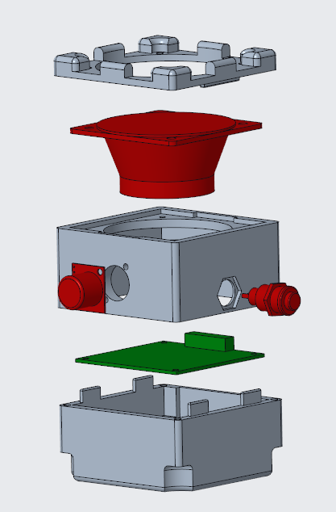
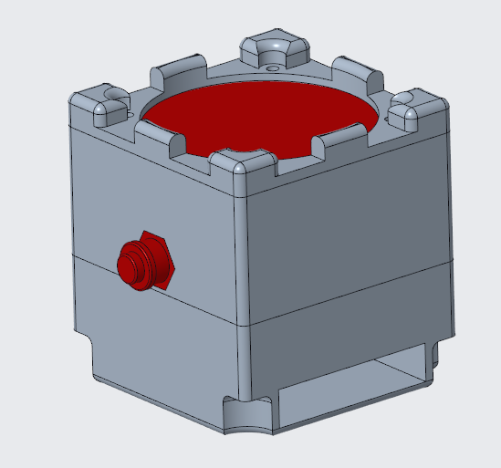
Mechanical

Slide 4
Computer Work
Thread Firmware Initialization Bug Fix
Resolved startup crash caused by duplicate radio registration
Discovered that calling otSysInit() before otInstanceInitSingle() was causing the radio to register with the system twice, which crashed the firmware on startup.
Traced the crash to the crypto/random number generator failing as a side effect of the duplicate registration.
Fixed the issue by removing the otSysInit() call and letting otInstanceInitSingle() handle all initialization on its own

Slide 5
Electrical Work
PR’s for PCB’s, stencil, and components sent to ISL (03/26/2026) Waiting for ISL approval
Updated RF trace width to match KiCad calculator result

Slide 6
Project Video
2-3 Minutes
Sections:
Qorvo Introduction
QPG6200L Basics
Project Description
Purpose
Functionality
RF Communications

